Slide 1
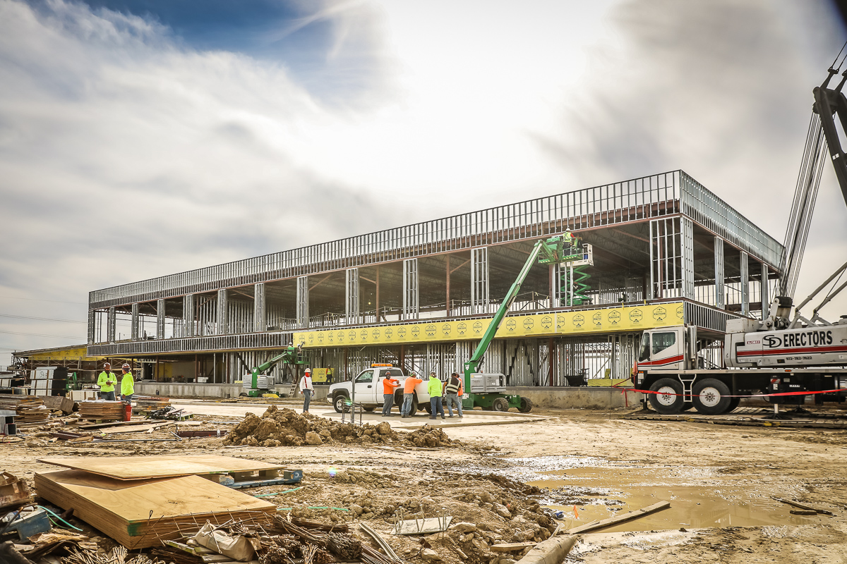
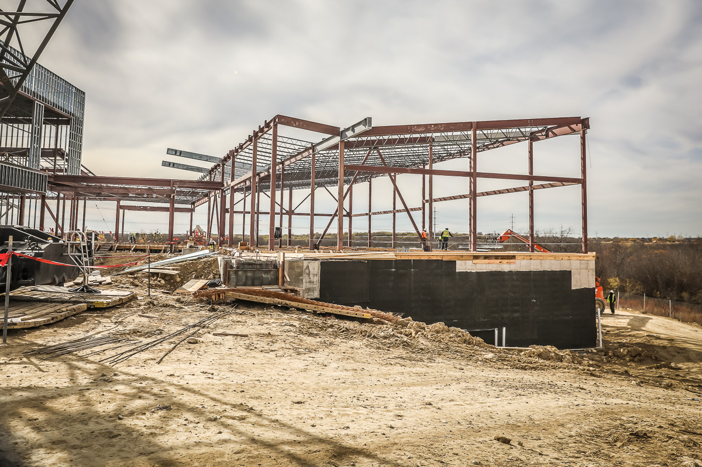
NEW ADMINISTRATION BUILDING
The deck is installed, foundation poured, and iron work for roof is ongoing in Area A.
Exterior sheathing, framing, roof installation, and fire sprinkler installation continues in Area B.

Slide 2
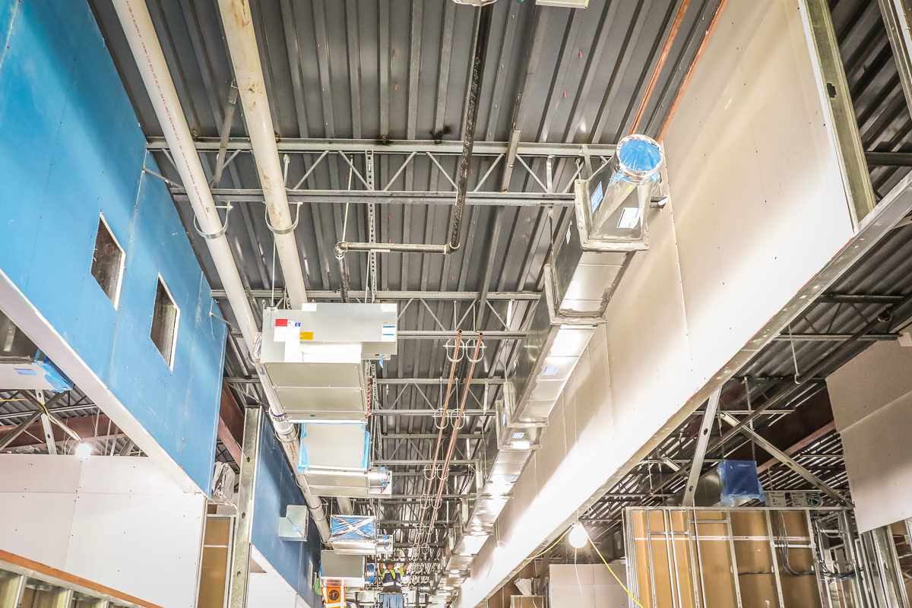
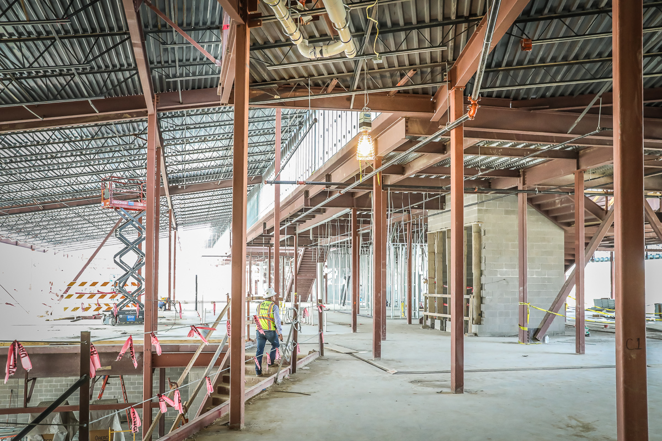
In Area B, roof deck and framing continue. CMU for elevator shaft is complete.
Area C, duct work, and air handler installation are ongoing. Sheetrock is one-sided, and second side is beginning.

Slide 3
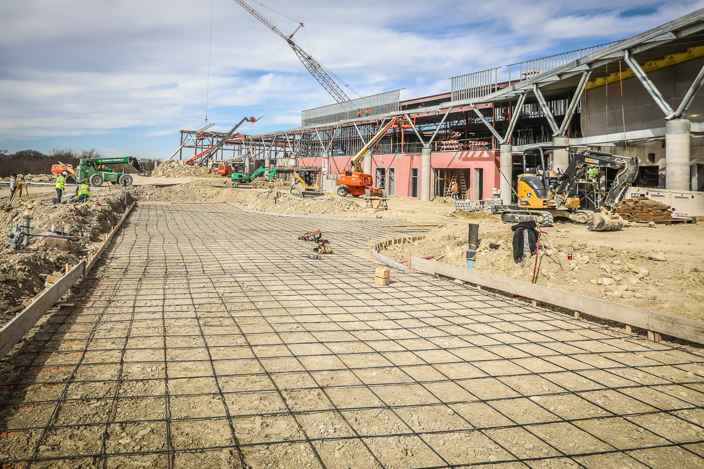
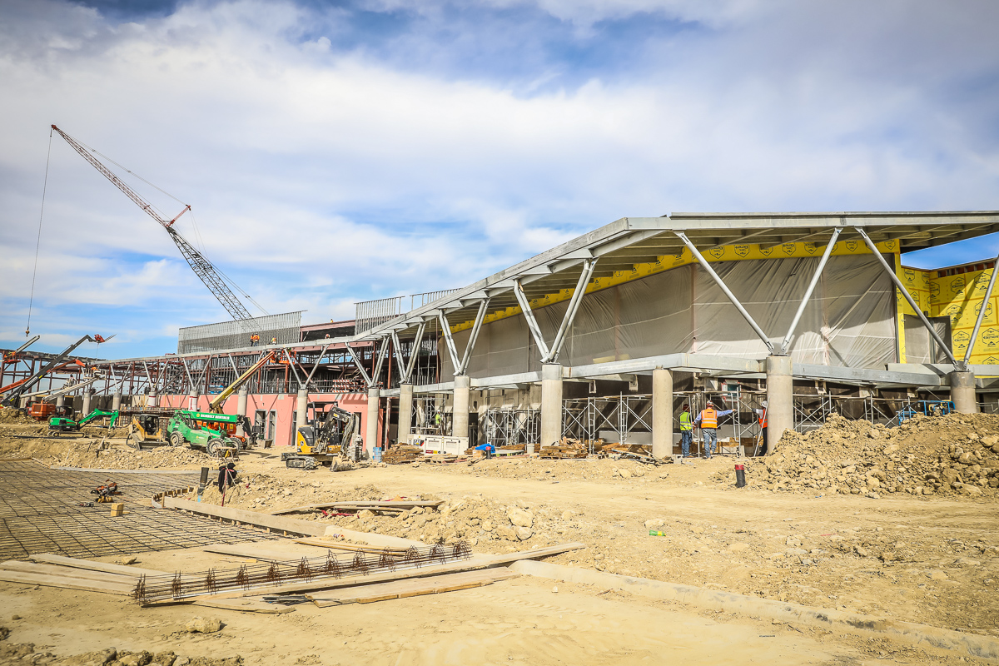
In Area C, the west side of building is dried in and structural steel installation on top of columns for the roof overhang support is in progress. Rebar is ready for pour of the fire lane.
Parapet framing in Area B, and joist installation in Area A is ongoing.

Slide 4
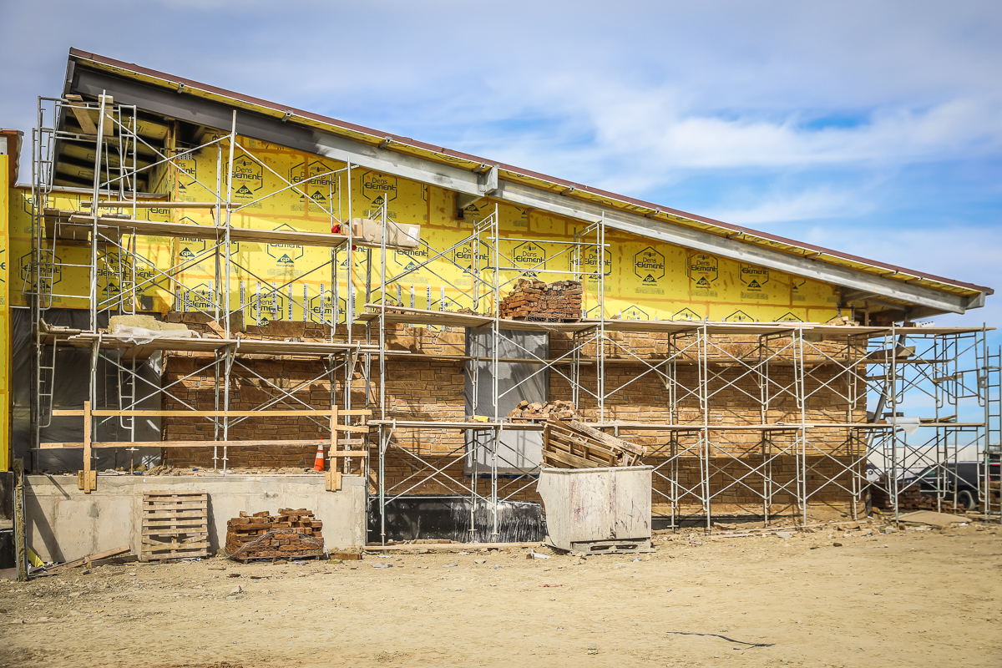
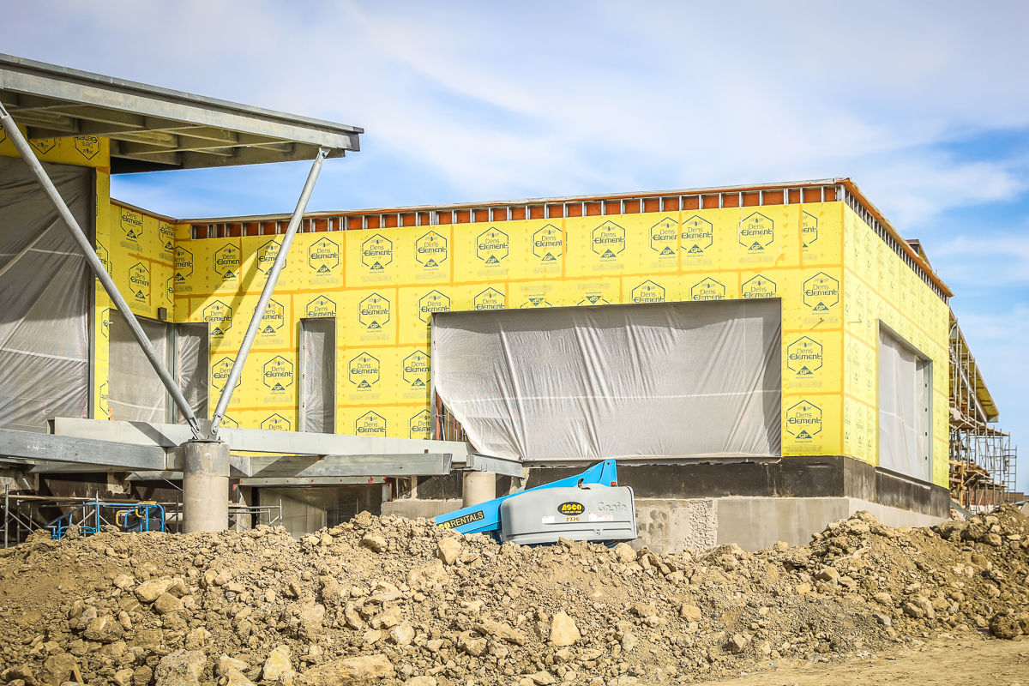
Area C is dried in, and stone installation on south end of building is in progress.

Slide 5
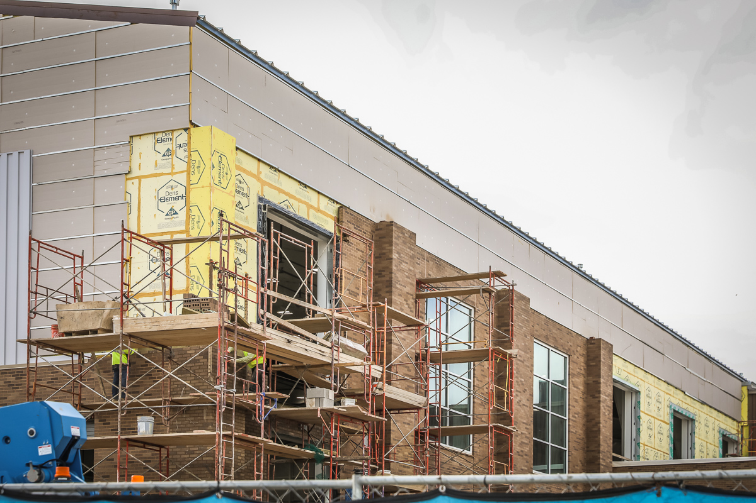
BOSWELL HS
North wall brick installation is ongoing on the turf building.

Slide 6
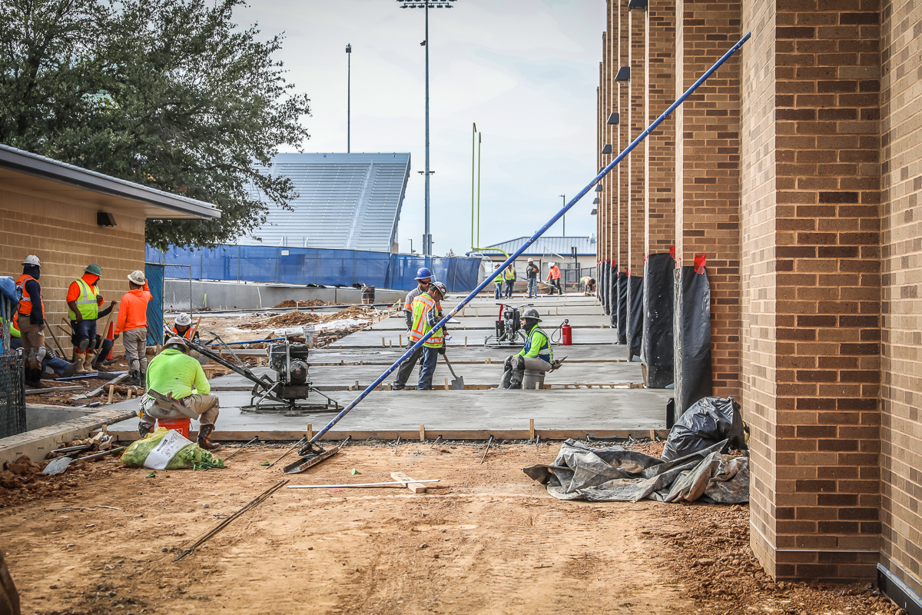
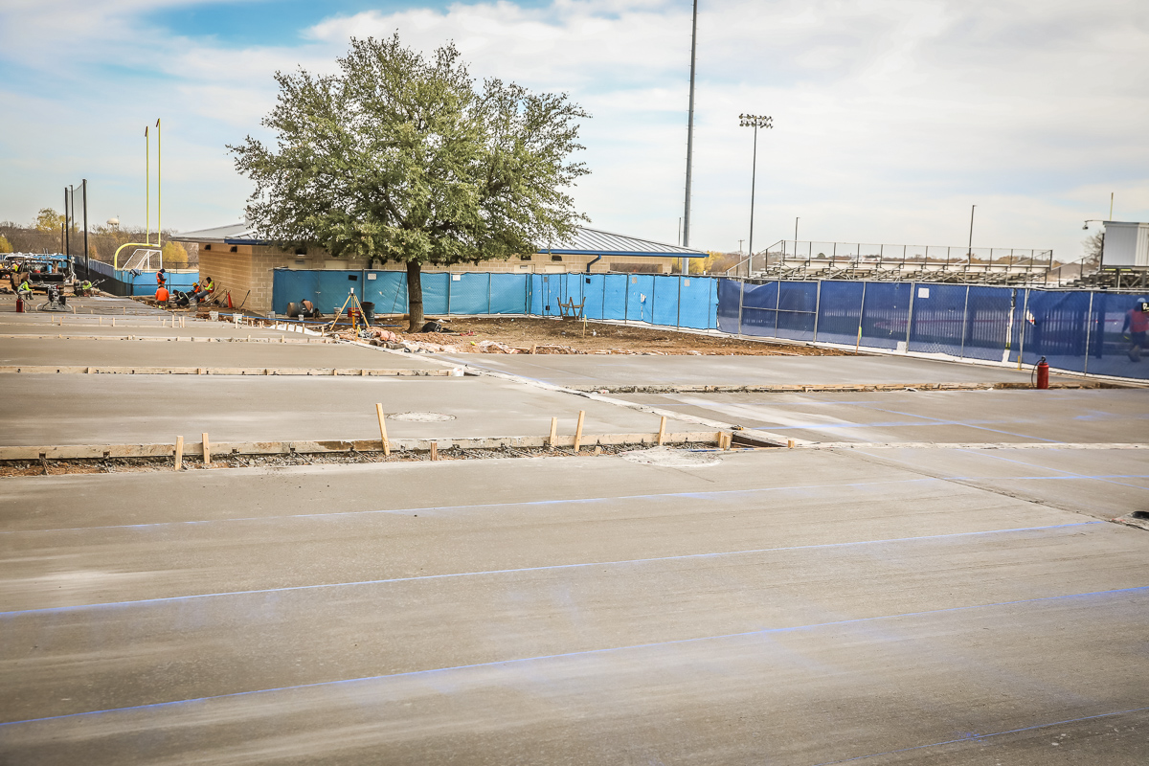
Concrete poured in turf building plaza, south of turf building and north of visitor bleachers. Photo shows leave out areas for future pour of color concrete.

Slide 7
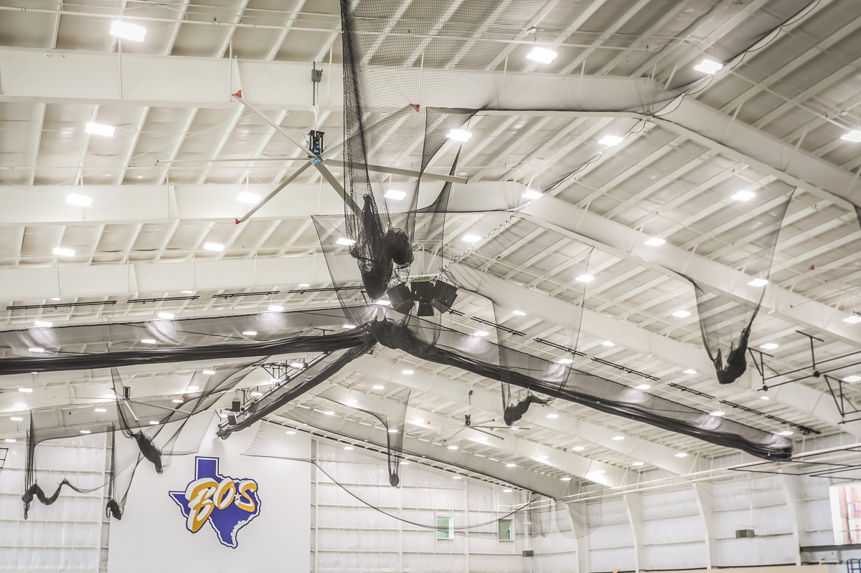
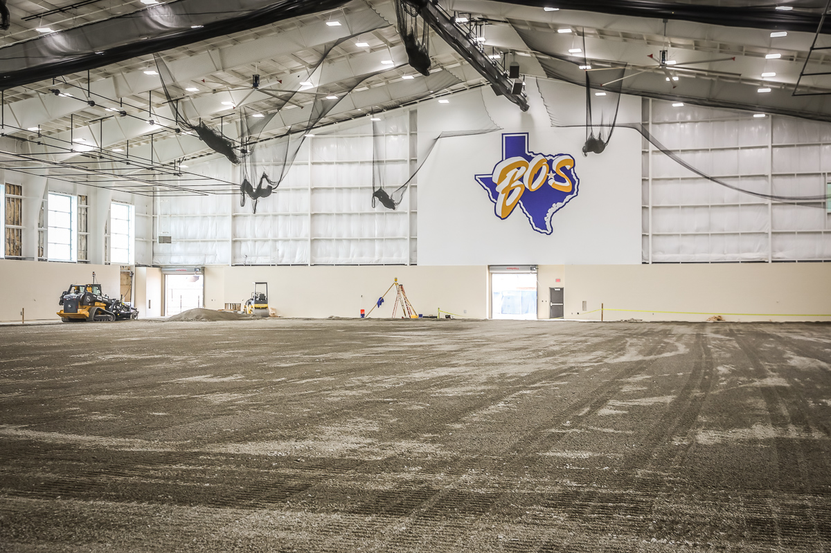
Fine grading of stone before installation of e-layer is ongoing.
Netting installation, dividers, ceiling protection, and batting cages in progress.

Slide 8
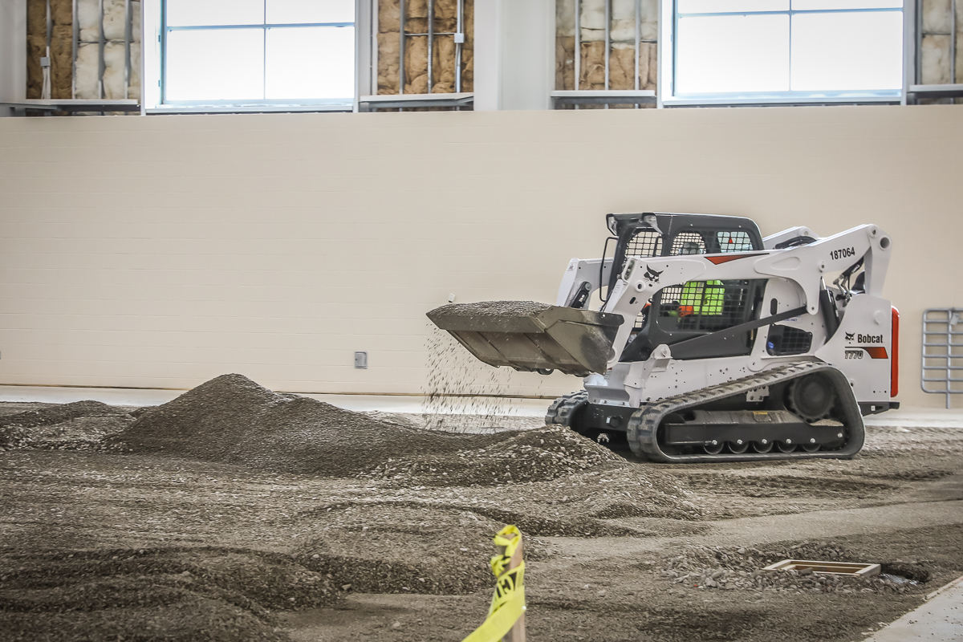
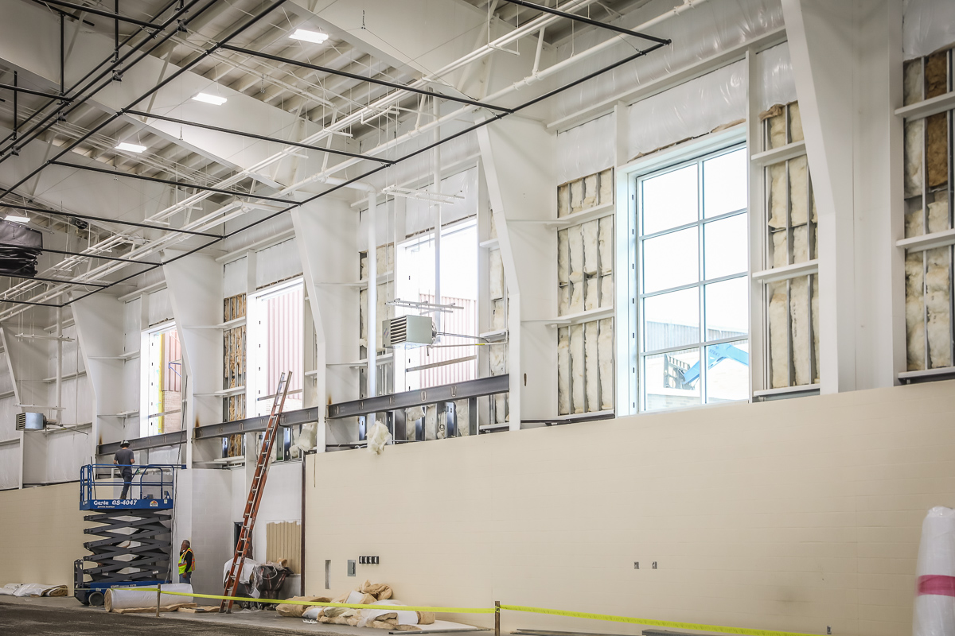
Completing last of wall of insulation in turf building.
Spreading stone for synthetic turf base is in progress.

Slide 9
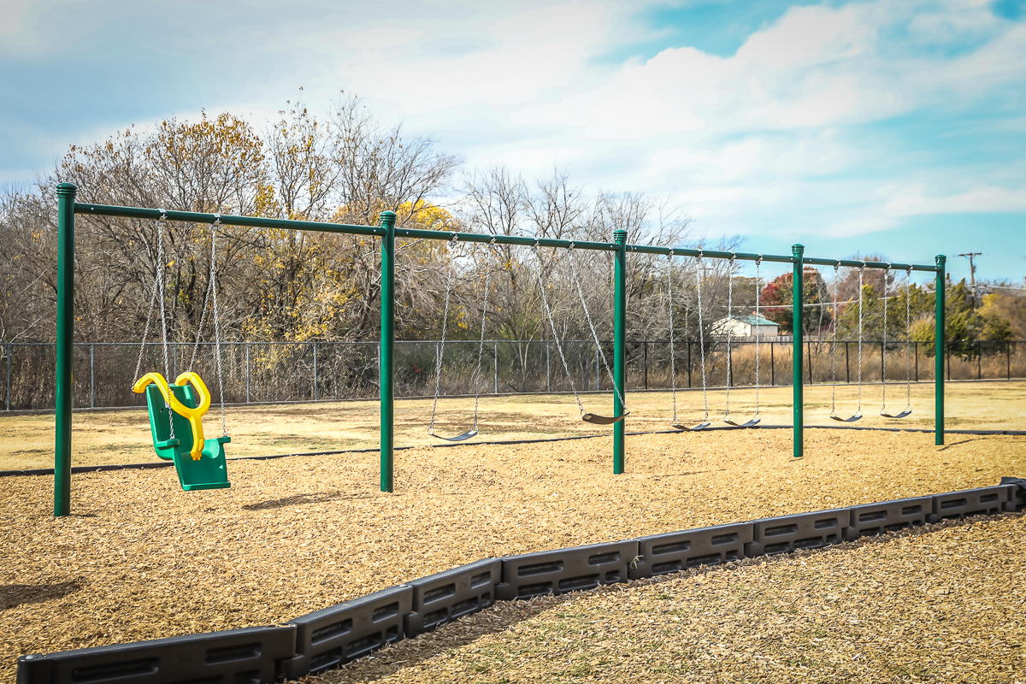
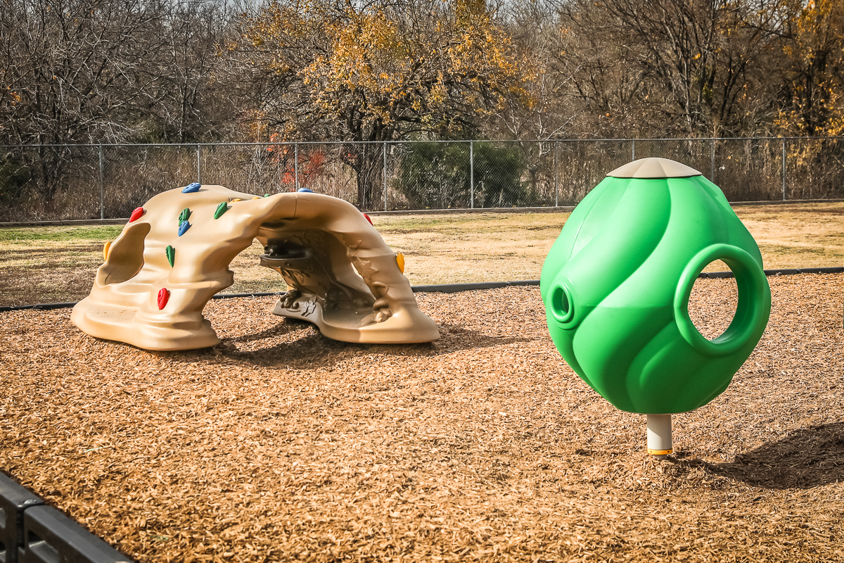
PLAYGROUND IMPROVEMENTS
Campuses identified received the Discovery Cave and Spinning Cozy Pod.
Photo shows new swing system at Northbrook ES. Elkins ES also received additional swings.

Slide 10
Elementary # 18/VLK Architects will present

